Slide 1


SUBJECT:
Advanced Java Programming
TOPIC:
Hibernate (HQL)
SUB-TOPIC:
Hibernate Architecture
HQL
Jatin Ambasana
This work is licensed under a Creative Commons Attribution-NonCommercial-ShareAlike 4.0 International License. You are free to use, distribute and modify it, for noncommercial purposes only, provided you acknowledge the source.

Slide 2
Introduction
What is JDBC?
JDBC stands for Java Database Connectivity and provides a set of Java API for accessing the relational databases from Java program.
These Java APIs enables Java programs to execute SQL statements and interact with any SQL database.
JDBC provides a flexible architecture to write a database independent application that can run on different platforms and interact with different DBMS.

Slide 3
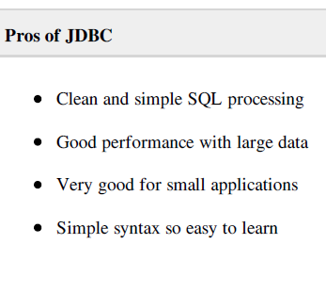
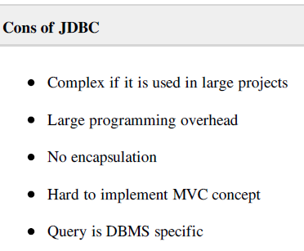
Pros and Cons of JDBC

Slide 4
Example
public class Employee {
private int id;
private String first_name;
private String last_name;
private int salary;
public Employee() {}
public Employee(String fname, String lname, int salary) {
this.first_name = fname;
this.last_name = lname;
this.salary = salary;
}

Slide 5
Cont.
public int getId() {
return id; }
public String getFirstName() {
return first_name; }
public String getLastName() {
return last_name; }
public int getSalary() {
return salary; } }

Slide 6
RDBMS table
create table EMPLOYEE (
id INT NOT NULL auto_increment,
first_name VARCHAR(20) default NULL,
last_name VARCHAR(20) default NULL,
salary INT default NULL,
PRIMARY KEY (id)
);

Slide 7
Problems
First problem, what if we need to modify the design of our database after having developed few pages or our application?
Second, Loading and storing objects in a relational database exposes us to the following five mismatch problems.

Slide 8
Problems??
Mismatch Description
Granularity : Sometimes you will have an object model which has more classes than the number of corresponding tables in the database.
Inheritance : RDBMSs do not define anything similar to Inheritance which is a natural paradigm in object-oriented programming languages.

Slide 9
Problems??
Identity : A RDBMS defines exactly one notion of 'sameness': the primary key. Java, however, defines both object identity (a==b) and object equality (a.equals(b)).
Associations : Object-oriented languages represent associations using object references where as am RDBMS represents an association as a foreign key column.
Navigation : The ways you access objects in Java and in a RDBMS are fundamentally different.

Slide 10
Hibernate
Hibernate is a high-performance Object/Relational and query service which is licensed under the open source GNU Lesser General Public License (LGPL) and is free to download.
Hibernate not only takes care of the mapping from Java classes to database tables (and from Java data types to SQL data types), but also provides data query and retrieval facilities.

Slide 11
Why Object Relational Mapping (ORM)?
When we work with an object-oriented systems, there's a mismatch between the object model and the relational database.
RDBMSs represent data in a tabular format whereas object-oriented languages, such as Java or C# represent it as an interconnected graph of objects.

Slide 12
What is ORM?
Object-Relational Mapping (ORM) is the solution to handle all the mismatches.
ORM stands for Object-Relational Mapping (ORM) is a programming technique for converting data between relational databases and object oriented programming languages such as Java, C# etc.

Slide 13
Cont.
Hibernate maps Java classes to database tables and from Java data types to SQL data types and relieve the developer from 95% of common data persistence related programming tasks.
Hibernate sits between traditional Java objects and database server to handle all the work in persisting those objects based on the appropriate O/R mechanisms and patterns.

Slide 14
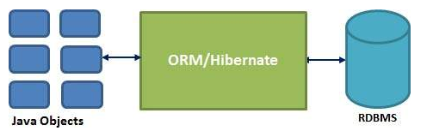
Cont.

Slide 15
Hibernate Advantages
Hibernate takes care of mapping Java classes to database tables using XML files and without writing any line of code.
Provides simple APIs for storing and retrieving Java objects directly to and from the database.
If there is change in Database or in any table then the only need to change XML file properties.

Slide 16
Architecture
The Hibernate architecture is layered to keep you isolated from having to know the underlying APIs.
Hibernate makes use of the database and configuration data to provide persistence services (and persistent objects) to the application.
Persistent Objects are the ones who give an indication that the state of an object would be permanently stored even after the execution of the program.

Slide 17
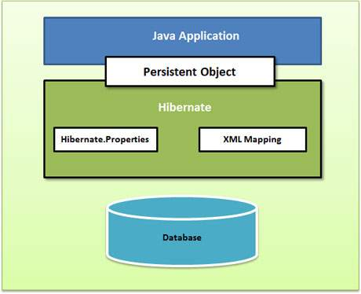
Cont.
Following is a very high level view of the Hibernate Application Architecture.

Slide 18
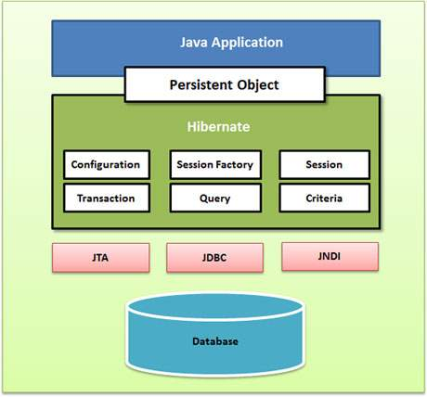
Cont.
Following is a detailed view of the Hibernate Application Architecture with few important core classes.

Slide 19
Cont.
Hibernate uses various existing Java APIs, like JDBC, Java Transaction API(JTA), and Java Naming and Directory Interface (JNDI).
JDBC provides abstraction of functionality common to relational databases, allowing almost any database with a JDBC driver to be supported by Hibernate.
JNDI and JTA allow Hibernate to be integrated with J2EE application servers.

Slide 20
Cont.
Configuration Object:
The Configuration object is the first Hibernate object you create in any Hibernate application and usually created only once during application initialization.
SessionFactory Object:
Configuration object is used to create a SessionFactory object which inturn configures Hibernate for the application using the supplied configuration file and allows for a Session object to be instantiated.

Slide 21
Cont.
Transaction Object:
A Transaction represents a unit of work with the database and most of the RDBMS supports transaction functionality.
Transactions in Hibernate are handled by an underlying transaction manager and transaction.

Slide 22
Cont.
Query Object:
Query objects use SQL or Hibernate Query Language (HQL) string to retrieve data from the database and create objects. A Query instance is used to bind query parameters, limit the number of results returned by the query, and finally to execute the query.
Criteria Object:
Criteria object are used to create and execute object oriented criteria queries to retrieve objects.

Slide 23
Hibernate - O/R Mappings
These are the 3 mapping.
Mapping of collections,
Mapping of associations between entity classes
Component Mappings.

Slide 24
Cont.
Collections Mappings:
If an entity or class has collection of values for a particular variable, then we can map those values using any one of the collection interfaces available in java.
Hibernate can persist instances of java.util.Map, java.util.Set, java.util.SortedMap, java.util.SortedSet, java.util.List, and any array of persistent entities or values.

Slide 25
Cont.
.
Collection type | Mapping and Description
java.util.Set | This is mapped with a <set> element and initialized with java.util.HashSet
java.util.SortedSet | This is mapped with a <set> element and initialized with java.util.TreeSet. The sort attribute can be set to either a comparator or natural ordering.
java.util.List | This is mapped with a <list> element and initialized with java.util.ArrayList
java.util.Collection | This is mapped with a <bag> or <ibag> element and initialized with java.util.ArrayList
java.util.Map | This is mapped with a <map> element and initialized with java.util.HashMap
java.util.SortedMap | This is mapped with a <map> element and initialized with java.util.TreeMap. The sort attribute can be set to either a comparator or natural ordering.

Slide 26
Cont.
If you want to map a user defined collection interfaces which is not directly supported by Hibernate, you need to tell Hibernate about the semantics of your custom collections

Slide 27
Cont.
Association Mappings:
The mapping of associations between entity classes and the relationships between tables is the soul of ORM.
Following are the four ways in which the cardinality of the relationship between the objects can be expressed.
An association mapping can be unidirectional as well as bidirectional.

Slide 28
Cont.
Mapping type | Description
Many-to-One | Mapping many-to-one relationship using Hibernate
One-to-One | Mapping one-to-one relationship using Hibernate
One-to-Many | Mapping one-to-many relationship using Hibernate
Many-to-Many | Mapping many-to-many relationship using Hibernate
.

Slide 29
Cont.
Component Mappings:
It is very much possible that an Entity class can have a reference to another class as a member variable.
If the referred class does not have it's own life cycle and completely depends on the life cycle of the owning entity class, then the referred class hence therefore is called as the Component class.

Slide 30
Cont.
Mapping type | Description
Component Mappings | Mapping for a class having a reference to another class as a member variable.
.

Slide 31
Hibernate - Mapping Files
An Object/relational mappings are usually defined in an XML document.
This mapping file instructs Hibernate how to map the defined class or classes to the database tables.

Slide 32
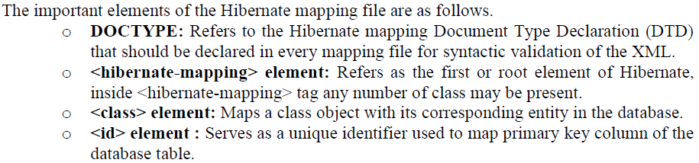
Cont.

Slide 33
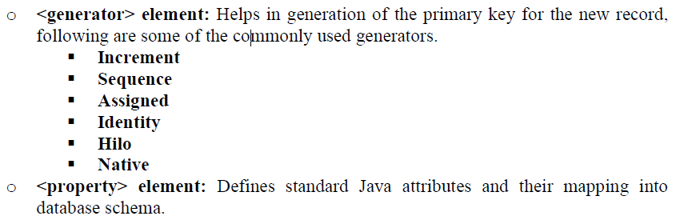
Cont.

Slide 34
Hibernate - Mapping Types
When you prepare a Hibernate mapping document, we have seen that you map Java data types into RDBMS data types.
The types declared and used in the mapping files are not Java data types; they are not SQL database types either.
These types are called Hibernate mapping types, which can translate from Java to SQL data types and vice versa.

Slide 35
Cont.
Primitive types:
Mapping type | Java type | ANSI SQL Type
integer | int or java.lang.Integer | INTEGER
long | long or java.lang.Long | BIGINT
short | short or java.lang.Short | SMALLINT
float | float or java.lang.Float | FLOAT
double | double or java.lang.Double | DOUBLE
big_decimal | java.math.BigDecimal | NUMERIC

Slide 36
Cont.
Date and time types:
Mapping type | Java type | ANSI SQL Type
date | java.util.Date or java.sql.Date | DATE
time | java.util.Date or java.sql.Time | TIME
timestamp | java.util.Date or java.sql.Timestamp | TIMESTAMP
calendar | java.util.Calendar | TIMESTAMP
calendar_date | java.util.Calendar | DATE

Slide 37
Cont.
Binary and large object types:
Mapping type | Java type | ANSI SQL Type
binary | byte[] | VARBINARY (or BLOB)
text | java.lang.String | CLOB
serializable | any Java class that implements java.io.Serializable | VARBINARY (or BLOB)
clob | java.sql.Clob | CLOB
blob | java.sql.Blob | BLOB

Slide 38
Cont.
JDK-related types:
Mapping type | Java type | ANSI SQL Type
class | java.lang.Class | VARCHAR
locale | java.util.Locale | VARCHAR
timezone | java.util.TimeZone | VARCHAR
currency | java.util.Currency | VARCHAR

Slide 39
HIBERNATE QUERY LANGUAGE
Hibernate Query Language (HQL) is an object-oriented query language, similar to SQL, but instead of operating on tables and columns, HQL works with persistent objects and their properties.
HQL queries are translated by Hibernate into conventional SQL queries which in turns perform action on database.

Slide 40
Cont.
Although you can use SQL statements directly with Hibernate using Native SQL but It would recommend to use HQL whenever possible to avoid database portability hassles, and to take advantage of Hibernate's SQL generation.
Keywords like SELECT , FROM and WHERE etc. are not case sensitive but properties like table and column names are case sensitive in HQL.

Slide 41
FROM Clause
You will use FROM clause if you want to load a complete persistent objects into memory. Following is the simple
String hql = "FROM Employee";
Query query = session.createQuery(hql);
List results = query.list();
If you need to fully qualify a class name in HQL, just specify the package and class name as follows:
String hql = "FROM com.hibernatebook.criteria.Employee";
Query query = session.createQuery(hql);
List results = query.list();

Slide 42
SELECT Clause
The SELECT clause provides more control over the result set than the from clause. If you want to obtain few properties of objects instead of the complete object, use the SELECT clause.
Following is the simple syntax of using SELECT clause to get just first_name field of the Employee object:
String hql = "SELECT E.firstName FROM Employee E";
Query query = session.createQuery(hql);
List results = query.list();

Slide 43
WHERE Clause
If you want to narrow the specific objects that are returned from storage, you use the WHERE clause.
Following is the simple syntax of using WHERE clause:
String hql = "FROM Employee E WHERE E.id = 10";
Query query = session.createQuery(hql);
List results = query.list();

Slide 44
ORDER BY Clause
To sort your HQL query's results, you will need to use the ORDER BY clause. of using ORDER BY clause:
String hql = "FROM Employee E WHERE E.id > 10 ORDER BY E.salary DESC";
Query query = session.createQuery(hql);
List results = query.list();
If you wanted to sort by more than one property, clause, separated by commas as follows:
String hql = "FROM Employee E WHERE E.id > 10 " +
"ORDER BY E.firstName DESC, E.salary DESC ";
Query query = session.createQuery(hql);
List results = query.list();

Slide 45
GROUP BY Clause
This clause lets Hibernate pull information from the database and group it based on a value of an attribute and, typically, use the result to include an aggregate value
String hql = "SELECT SUM(E.salary), E.firstName FROM Employee E " +
"GROUP BY E.firstName";
Query query = session.createQuery(hql);
List results = query.list();

Slide 46
UPDATE Clause
The Query interface now contains a method called executeUpdate() for executing HQL UPDATE or DELETE statements.
String hql = "UPDATE Employee set salary = :salary " +
"WHERE id = :employee_id";
Query query = session.createQuery(hql);
query.setParameter("salary", 1000);
query.setParameter("employee_id", 10);
int result = query.executeUpdate();
System.out.println("Rows affected: " + result);

Slide 47
DELETE Clause
The DELETE clause can be used to delete one or more objects. Following is the simple syntax of using DELETE clause:
String hql = "DELETE FROM Employee " +
"WHERE id = :employee_id";
Query query = session.createQuery(hql);
query.setParameter("employee_id", 10);
int result = query.executeUpdate();
System.out.println("Rows affected: " + result);

Slide 48
INSERT Clause
HQL supports INSERT INTO clause only where records can be inserted from one object to another object.
String hql = "INSERT INTO Employee(firstName, lastName, salary)" +
"SELECT firstName, lastName, salary FROM old_employee";
Query query = session.createQuery(hql);
int result = query.executeUpdate();
System.out.println("Rows affected: " + result);

Slide 49
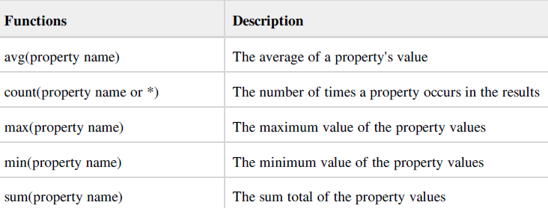
Aggregate Methods
HQL supports a range of aggregate methods, similar to SQL. They work the same way in HQL as in SQL and following is the list of the available functions:

